Slide 1
Modern SOA Methodologies
Perspectives on SOC
Paul Buhler, PhD
Chief Scientist
Modus21
April 21, 2010

Slide 2
Presentation Overview
Architectural Layering
Traditional vs. Distributed Systems Assumptions
Great Principles of Computing
Importance of Business Architecture
Process Perspectives
Contemporary SOC Platform

Slide 3
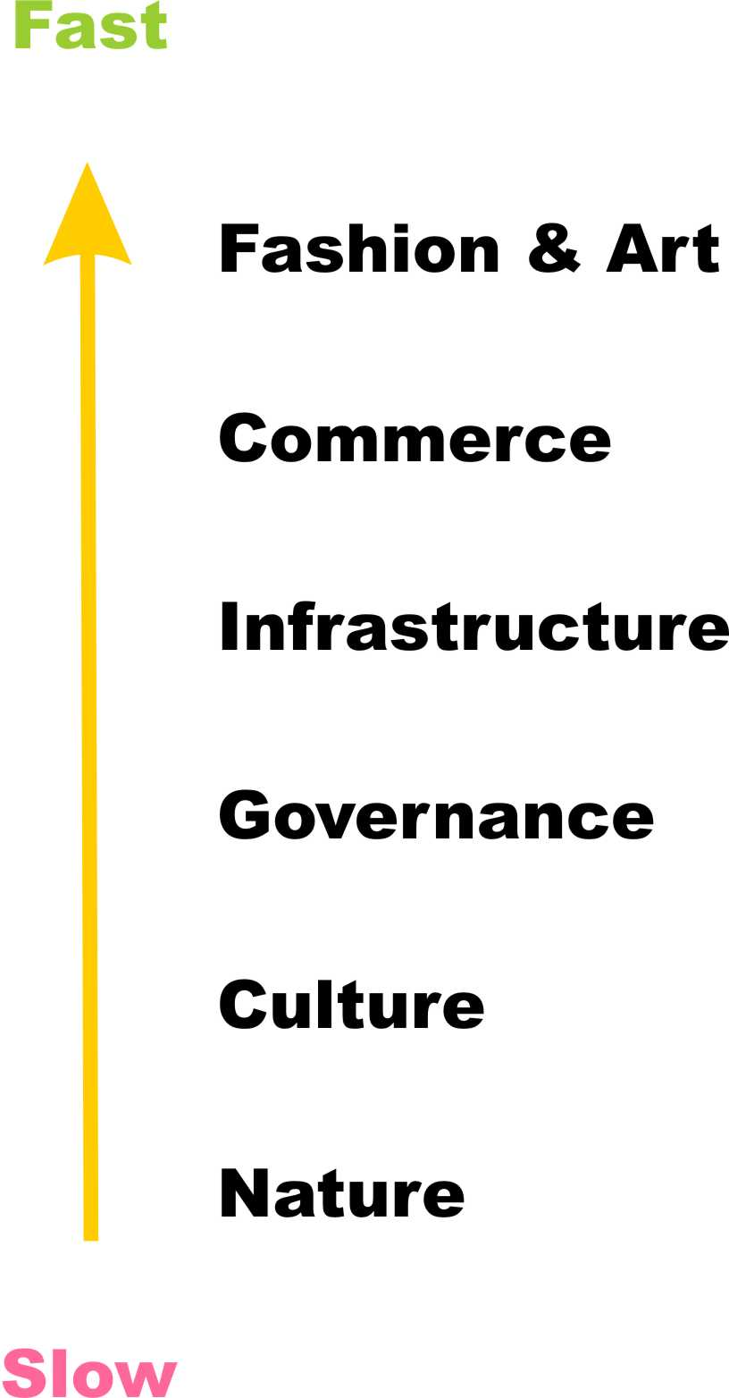
Pace of Change in Society
Layering is natural occurring
Clock of the Long Now presents the idea of societal layers
As described by Peter Morville, “The slow layers provide stability. The fast layers drive innovation.”
http://semanticstudios.com/publications/semantics/000003.php
Notes:
http://semanticstudios.com/publications/semantics/000003.php

Slide 4
Standards are Layered
Standards define a point of homogeneity amongst vendor products above which vendors build their value-added feature sets to differentiate their products in the marketplace.
Standards work by freezing innovation at one level, allowing more of it at higher levels.
Standardization works from the bottom up, from more basic and broadly-used technologies to more sophisticated and narrowly-used ones.
Notes:
Bullet one – Gordon Bell, A Time and Place for Standards, http://portal.acm.org/citation.cfm?id=1028900
Pieter Hintjens of iMatix Corporation when commenting on the issuses with the AMQP standardization process. http://www.imatix.com/articles:whats-wrong-with-amqp (bullets two and three)

Slide 5
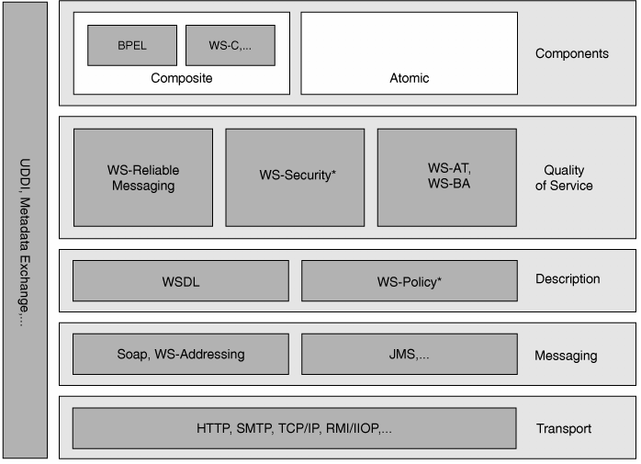
Layered Standards
Web Services Platform Architecture, ISBN-10: 0131488740, pg 34

Slide 6
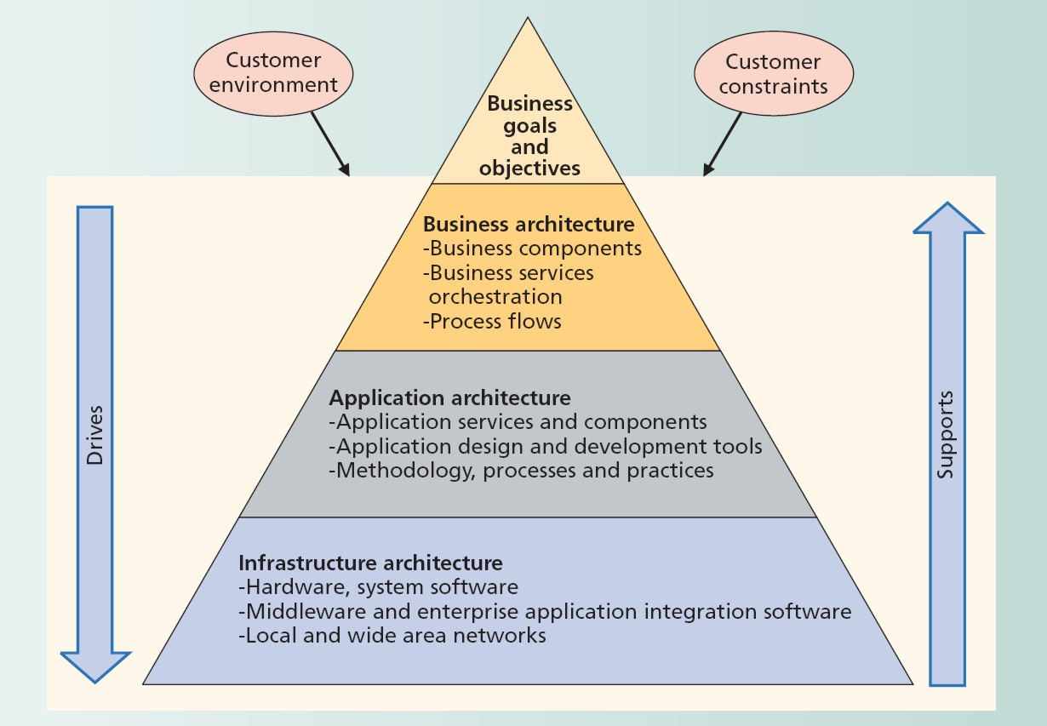
Architectures are Layered
March/April 2007, IT Pro Magazine, “The Role of Solution Architects in Systems Integration”
Notes:
March/April 2007, IEEE IT Pro Magazine, article “The Role of Solution Architects in Systems Integration”

Slide 7
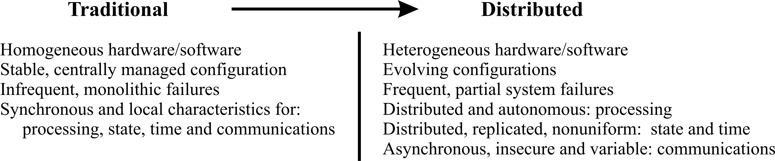
Changing Systems Assumptions
Transaction | Compensation
Design | Architecture
Creational | Compositional
Software Architect Bootcamp, ISBN-10: 0131412272, pg 13
Notes:
Software Architect Bootcamp

Slide 8
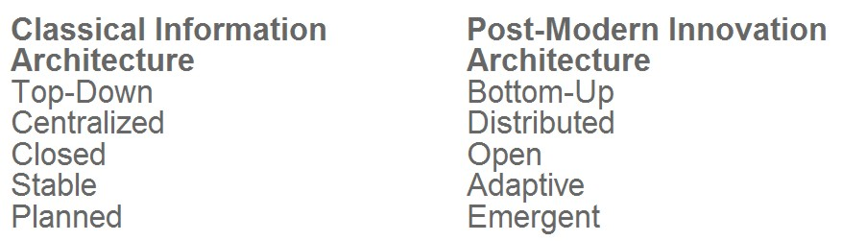
A Study of Contrasts
http://semanticstudios.com/publications/semantics/000005.php
Notes:
http://semanticstudios.com/publications/semantics/000005.php

Slide 9
Embracing Change
Transitioning from…
Traditional/Creational View
Application = Data Structures + Algorithms
To…
Distributed/Compositional View
Application = Computation + Coordination
Notes:
Restatement of Nicholas Wirth’s book titled Data Structures + Algorithms = Programs
Gelenter

Slide 10
Great Principles of Computing
Promoted by Prof. Peter Denning, NPS
Article of same title published CACM, 11/2003
The principles are of two kinds
Mechanics: how computations and computers work
Design: how to build them to work well

Slide 11
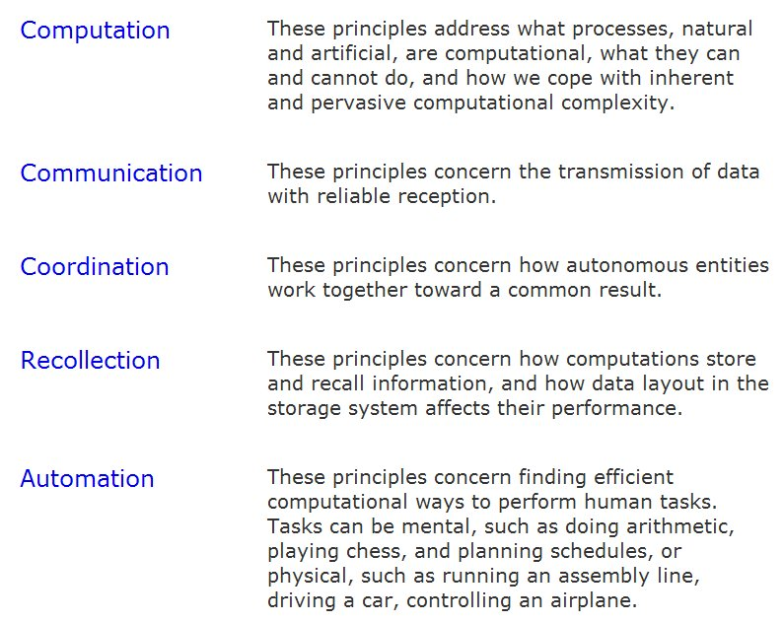
5 Windows of Computing Mechanics
http://cs.gmu.edu/cne/pjd/GP/gp_summary.html
Notes:
http://cs.gmu.edu/cne/pjd/GP/gp_summary.html
Computation – what can be computed and how; limits of computing
Communication – sending messages from one point to another
Coordination – multiple entities cooperating toward a single result
Recollection – storing and retrieving information
Automation – performing cognitive tasks by computer

Slide 12
Primary SOC System Layers
Process – Business Architecture
Coordination + Recollection
BPMS (Business Process Management Suite)
Service – Application Architecture
Computation
SOA (Service-Oriented Architecture)
Standards, Specifications, Principles, Patterns and Practice
Mediation – Infrastructure Architecture
Communication
ESB (Enterprise Service Bus)
Notes:
NOTE: each layer expresses all five of the computing mechanics in its own way; however, each layer has a primary responsibility

Slide 13
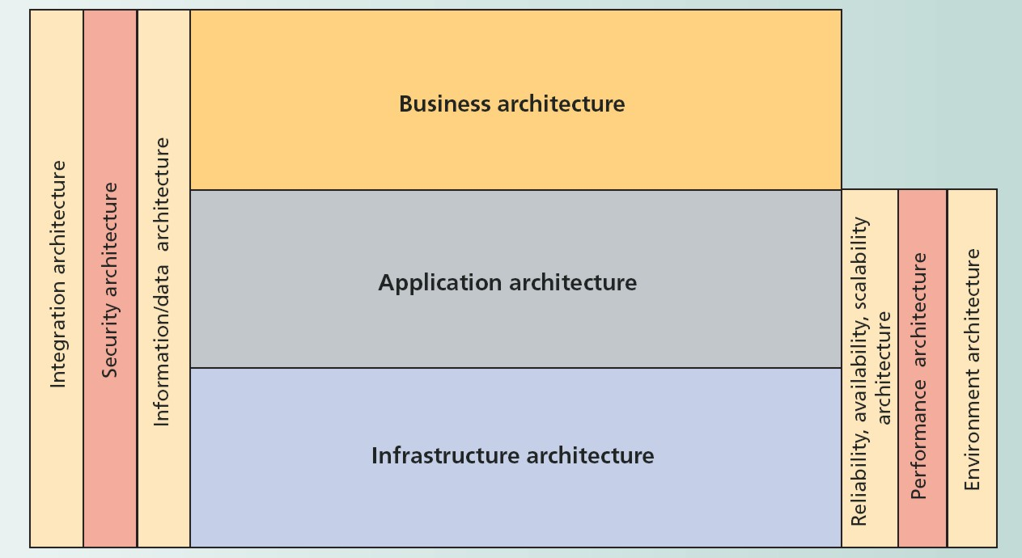
Supporting Layers
March/April 2007, IT Pro Magazine, “The Role of Solution Architects in Systems Integration”
Notes:
March/April 2007, IEEE IT Pro Magazine, article “The role of Solution Architects in Systems Integration”

Slide 14
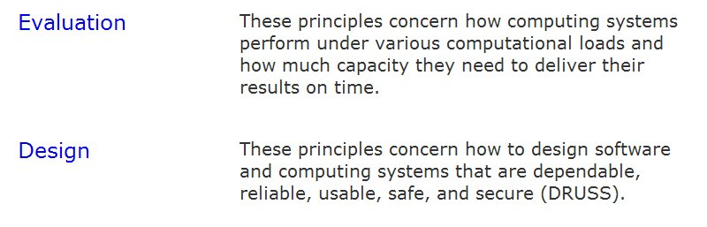
Supporting Principles
http://cs.gmu.edu/cne/pjd/GP/gp_summary.html
Role of the two principles of Computing Design

Slide 15
Commoditization of IT
Happening rapidly via virtualization technologies and cloud computing infrastructure
IT alone does not provide competitive advantage; IT becomes the platform upon which we execute our business processes.
The management science of Business Process Management (BPM) will become the differentiator.

Slide 16
Business Architecture
Business Architecture and design requires us to shift focus to reflect the point of view of the business designers and owners rather than a myopic view on IT solution delivery.
This point of view begins with business motivations, includes key business execution elements – such as operating model, capabilities, value chains, processes, and organizational models – and transcends information technology representations, such as business services, rules, events and information models.
The value of SOA needs to be measured in relation to Business Goals and Objectives.
Notes:
Bullets one and two based upon… Business Architecture: The Missing Link between Business Strategy and Enterprise Architecture, January 2010, OMG SOA Consortium

Slide 17
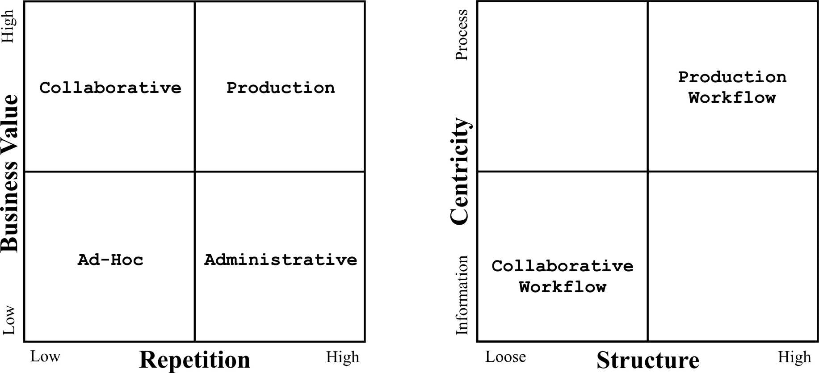
Process Types
All processes are not created equal!
Notes:
Paul Buhler and José M. Vidal. Towards Adaptive Workflow Enactment Using Multiagent Systems. Information
Technology and Management Journal, 6(1):61--87, 2005.

Slide 18
Problem Spaces
http://www.noop.nl/2008/08/simple-vs-complicated-vs-complex-vs-chaotic.html
Simple = easily knowable.
Complicated = not simple, but still knowable.
Complex = not fully knowable, but reasonably predictable.
Chaotic = neither knowable nor predictable.
Notes:
http://www.noop.nl/2008/08/simple-vs-complicated-vs-complex-vs-chaotic.html

Slide 19
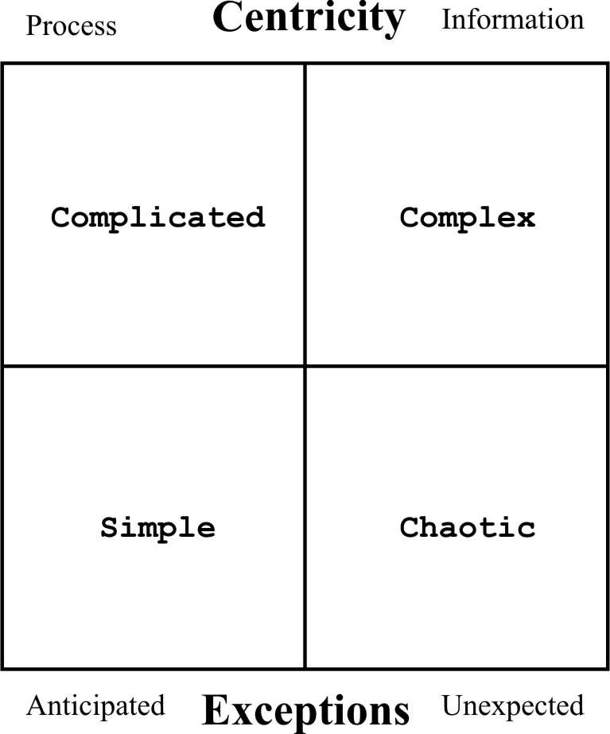
Another Perspective

Slide 20
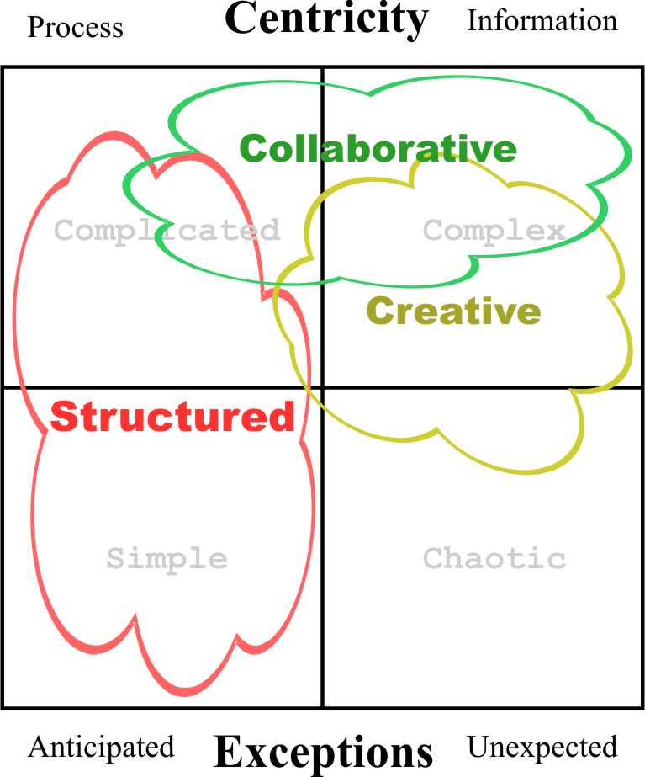
Solution Spaces
Notes:
Gartner’s Pattern-based Strategy defines structured, collaborative and creative

Slide 21
Beyond Orchestration
Collaboration
Software support for knowledge workers
Enterprise 2.0 social software is enabling technology
Creative Processes
Dynamic BPM
Assembly of process fragments @ runtime

Slide 22
Dealing with the Unexpected
To the mix of BPM, SOA, ESB we need to add EDA (Event Driven Architecture)
EDA – production, detection, consumption of, and reaction to events
EDA provides the means of creating sense and respond systems
Not just reactively, but proactively when combined with EDM (Enterprise Decision Mgmt)
Notes:
Bullet two - http://en.wikipedia.org/wiki/Event-driven_architecture

Slide 23
Enterprise Decision Management
Enterprise Decision Management (EDM)
business rule management systems and engines, data mining and predictive analytics technology, decision services in an SOA and adaptive control and optimization
EDM is at the essence of the 5th Principle of Computing Mechanics
Automation
Performance of cognitive tasks by computer
Notes:
Bullet one – from an advertisement for the EDM Summit
http://www.edmsummit.com/critical-enterprise-decision-management-technologies.php?zoom_highlight=funlabs

Slide 24
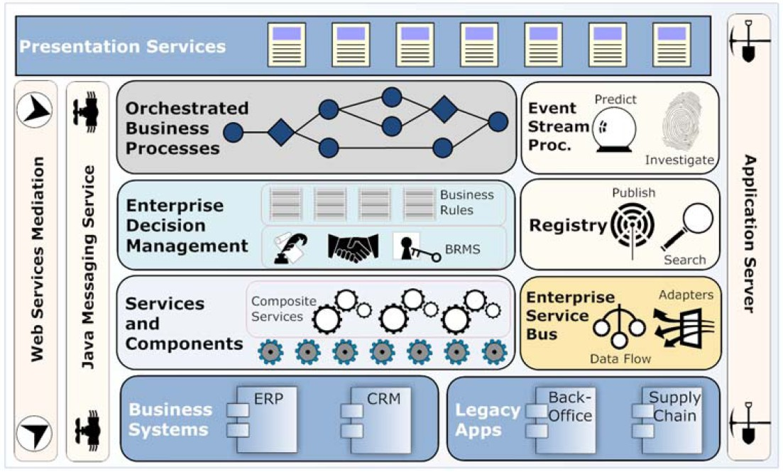
Contemporary SOC Platform
Open Source SOA, ISBN-10: 1933988541, pg 16
Notes:
Jeff Davis, http://www.manning.com/davis/SampleChapter1.pdf

Slide 25
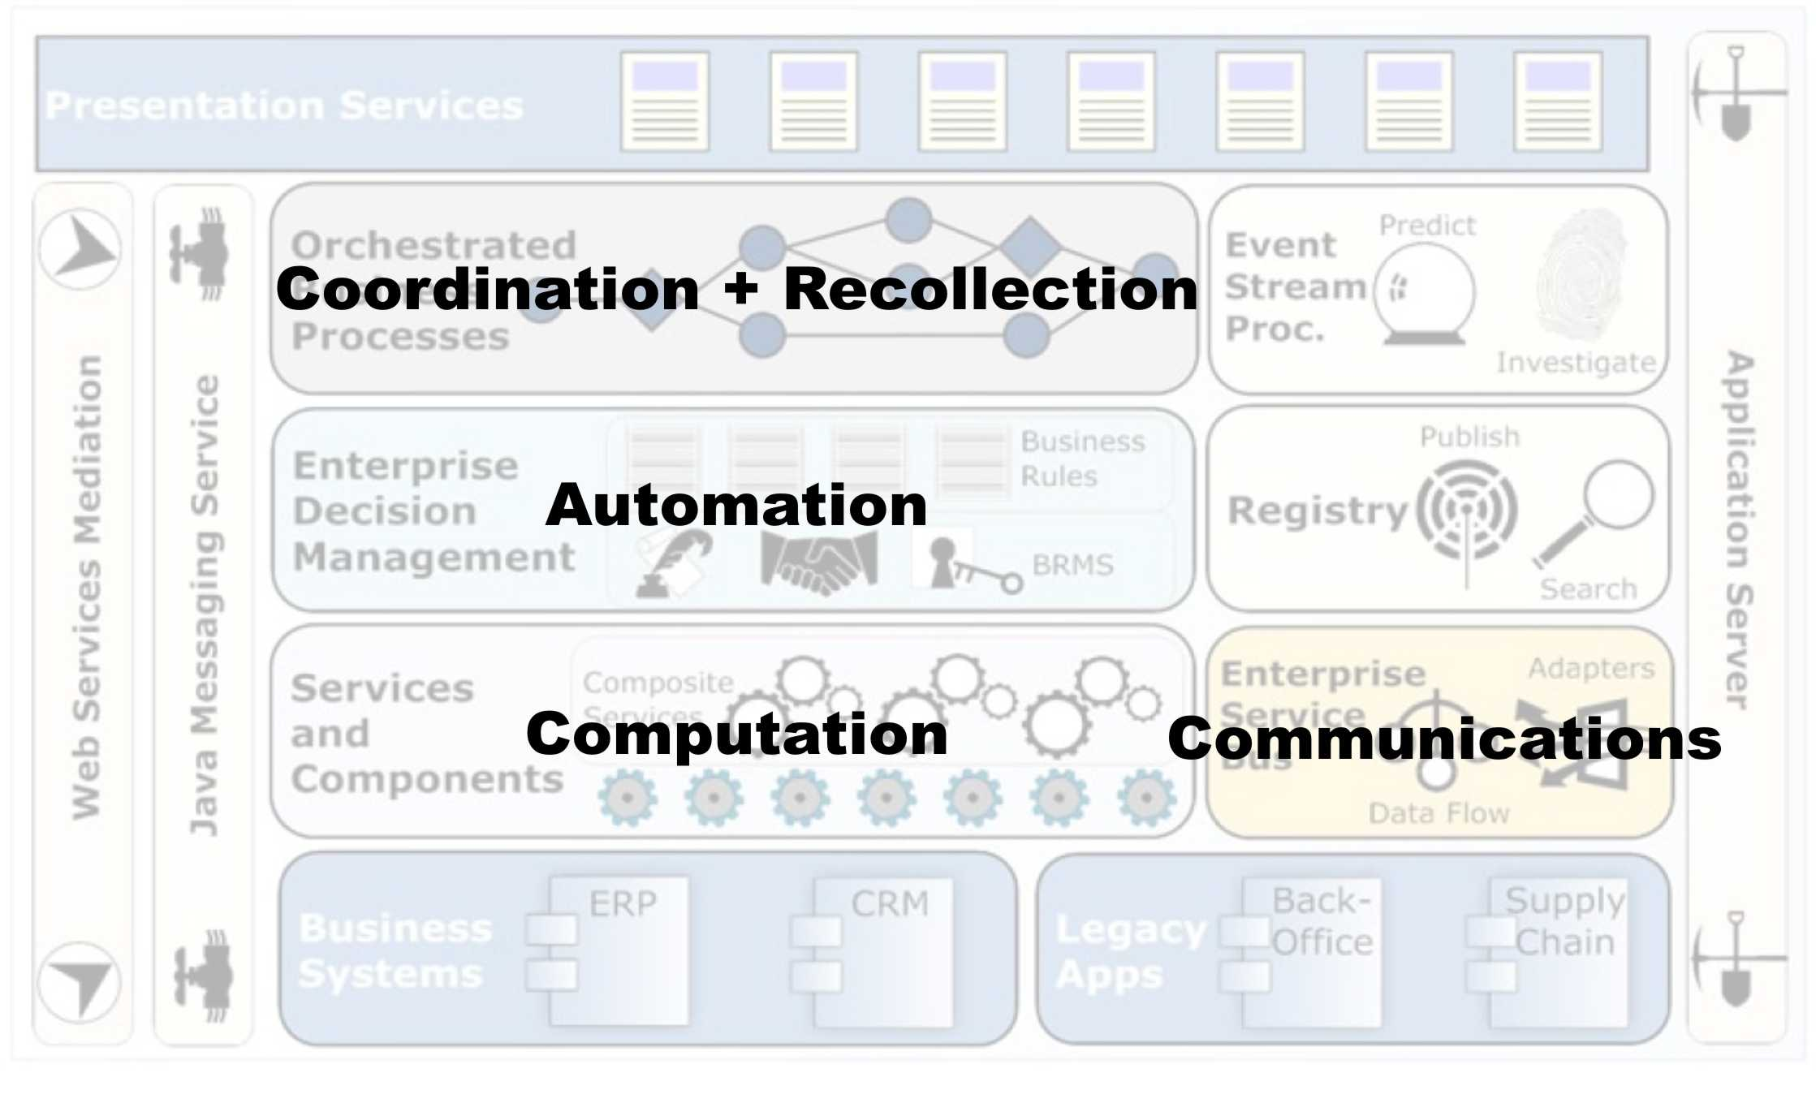
Principles and Platform

Slide 26
Summary and Conclusion
Great Principles of Computing are useful in helping us think about SOC
SOC can be viewed as a system of systems
Each system has primary responsibility for fulfilling the intent of one of the Great Principles of Computing.
It is through this synergistic interaction that the system fulfills its intent of delivering business value.
The whole is greater than the sum of its parts.

